Slide 1
Paleolithic:
AKA: “The Old Stone Age”
Hunter-Gathers
Nomadic
NO permanent settlements
Small populations
NEOLITHIC:
AKA: “The New Stone Age”
Agricultural Revolution= new farming technology
Domestication
Permanent Settlements
Towns and cities emerge
Increase in food supply= Increase in population
Social class emerge

Slide 3
Where did River Valley Civilizations Emerge?
Mesopotamia: Tigris, Euphrates
China: Huang-He, Yangtze
Egypt: Nile
India: Indus
Why did Early River
Civilizations develop along rivers?
Fertile soil
Easy to farm (irrigation)
Transportation
(trade, travel)
What does Mesopotamia mean?
“Land between two rivers”

Slide 4
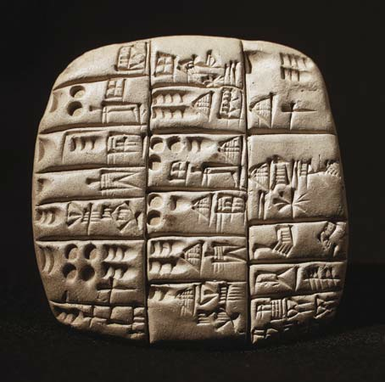
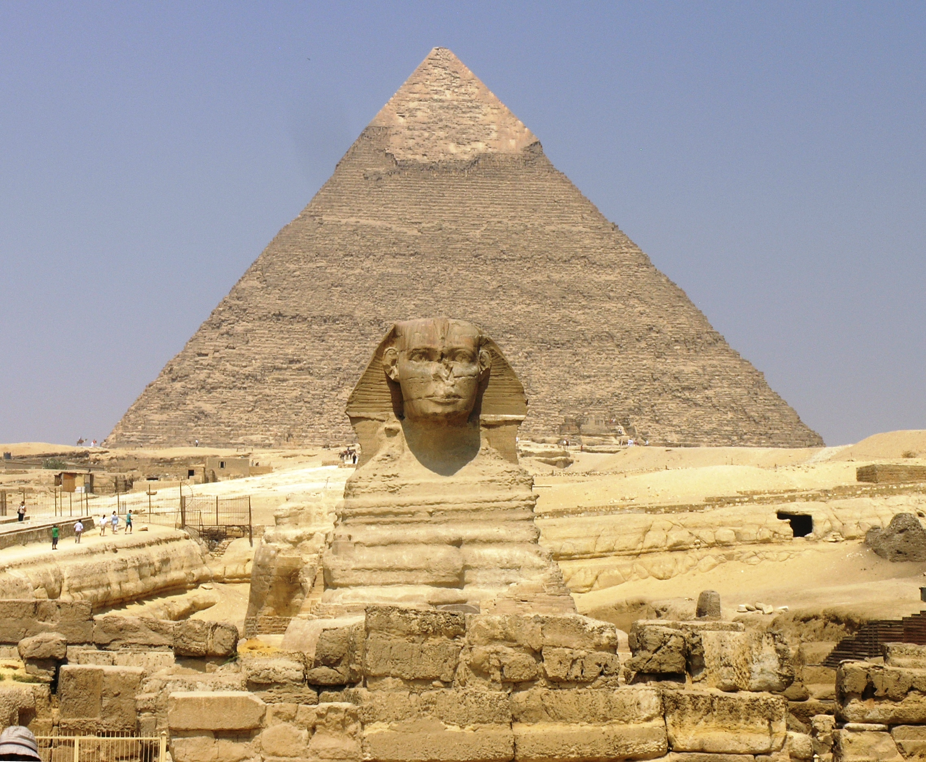
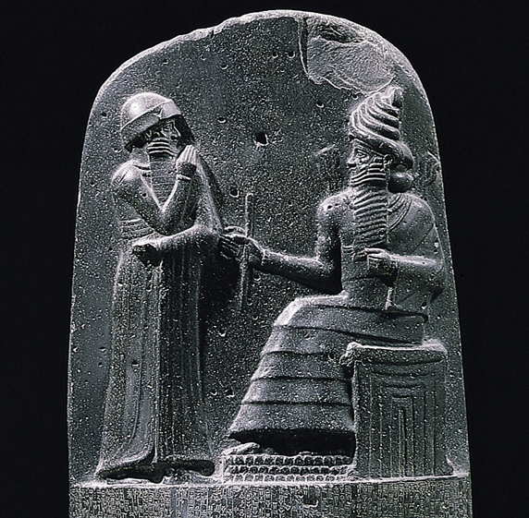
TIGRIS- EUPHRATES RIVER VALLEY (MESOPOTAMIA)
Polytheistic
Ziggurats- temples for different gods
Important civilization- Sumer
Cuneiform- writing system
Invention of the wheel
ANCIENT BABYLONIA
Mesopotamia
King Hammurabi
Hammurabi’s Code:
  First written code of laws for all to see.
  “Eye for an Eye”- laws and punishments
  Discriminates based on social classes
NILE RIVER (EGYPT)
Longest river in the world.
United Upper and Lower Egypt
Polytheistic
Pyramids
Pharaoh’s (viewed as god-kings)
Papyrus= paper
Hieroglyphics- writing system
Predictable flooding

Slide 5
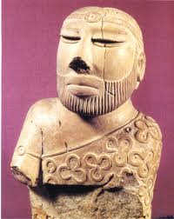
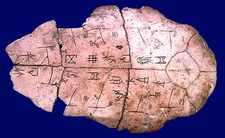
INDUS RIVER (INDIA)
Monsoons
Polytheistic
Planned cities: Harappa & Mohenjo-Daro
Evidence of strong central government.
Sanskrit- writing system
HUANG-HE & YELLOW RIVER VALLEY (CHINA)
Polytheistic
Yin-Yang= balance in nature
Ancestor worship
Oracle bones
Emperor
Pictographs: writing system
Shang Dynasty- first dynasty
Achievements: gunpowder; porcelain

Slide 6
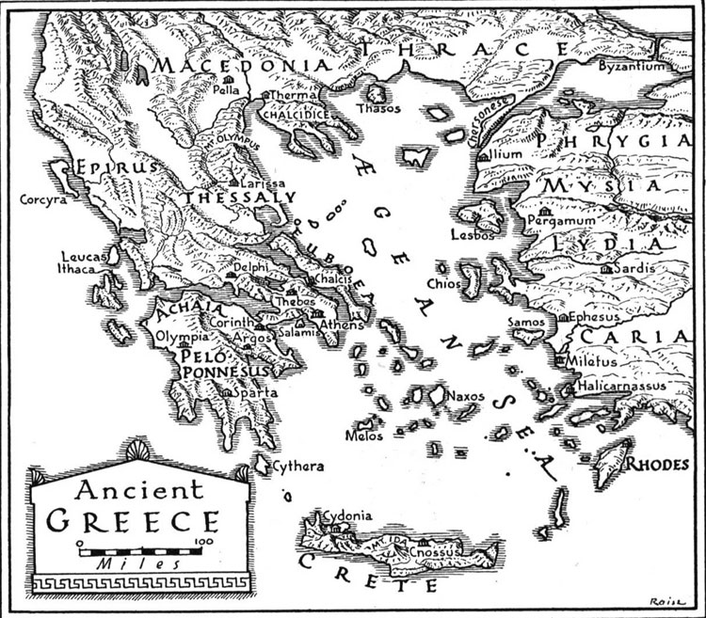
ANCIENT GREECE
How did geography impact the early inhabitants of Greece?
Isolated separate city-states and kept Greece from uniting. Different city-states had different forms of government.
Travel and trade based on water routes.
How did the mountainous topography impact the development of ancient Greece?
Few natural resources forced some city-state to look to expand their territories; protection; isolation.

Slide 7
SPARTA
ATHENS
  Oligarchy
  Based around the military
  Emphasized discipline and strength
  Women enjoyed considerable freedoms.
  GOLDEN AGE
  Limited democracy;
  Emphasized educations;
  Goal was to prepare to for times of peace and war;
  Limited freedom of speech,
  Women’s roles limited to managing the house.
  Language
  Religion
  Culture

Slide 8
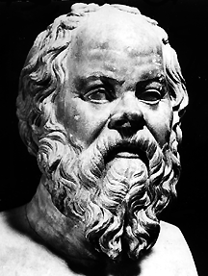
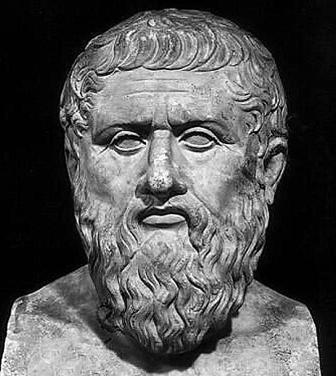
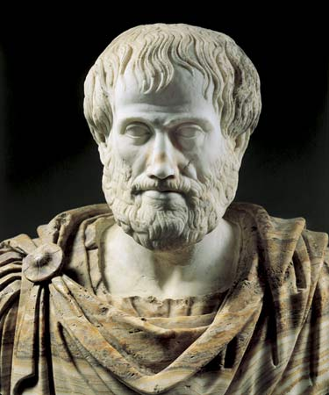
Socrates
SOCRATES
Developed “Socratic Method;”
Learn by asking;
Practical questions to find truth;
Athenian government rejected his thoughts and said he corrupted youth.
PLATO
Distrusted democracy because he felt it put Socrates to death;
Three classes of people with philosophers as the ruling class;
ARISTOTLE
People should pursue the nature of the world;
People learn through reason;
Astronomy, natural history, music, and politics.

Slide 9
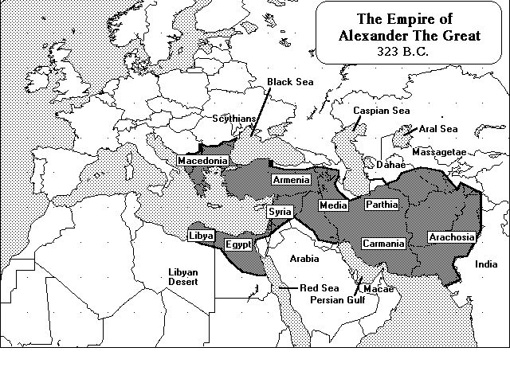
Greece

Slide 10
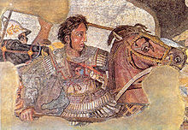
Alexander the Great- unites the Greek city-states through conquest, alliances, acceptance.
GREEK
PERSIAN
HELLENISTIC CULTURE
EGYPTIAN
INDIAN

